Slide 1

Reaching a Global Audience Through Search
Vanessa Fox
@vanessafox

Slide 2







Slide 3

http://www.flickr.com/photos/14646075@N03/3498450536/
Notes:
Normally like to have slide with inspirational pictures rather than words and bullets

Slide 4

http://www.flickr.com/photos/gadl/284995199/
But we only have 20 17 minutes.
And I just spent 30 seconds showing you that pretty picture.

Slide 5

Relevance
http://www.flickr.com/photos/mgaffney/62318211/

Slide 6
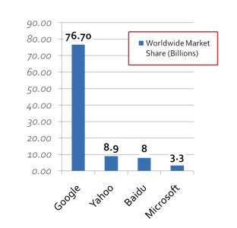
Search By The Numbers
1 billion
internet users worldwide
113 billion
searches each month worldwide
of people online
92% search monthly
of people online
Half search everyday
http://www.internetworldstats.com/stats.htm
http://askville.amazon.com/percentage-internet-users-search-engines/
AnswerViewer.do?requestId=13926336

Slide 7

Broadband Increases Time Online
“Those with broadband access spend more time online and are happier with their online experiences.”
95%
of internet users
http://www.websiteoptimization.com/bw/1001/
http://searchengineland.com/
pewinternet-study-finds-most-americans-get-their-answers-from-the-internet-13028
Notes:
95% of internet users have broadband access

Slide 8
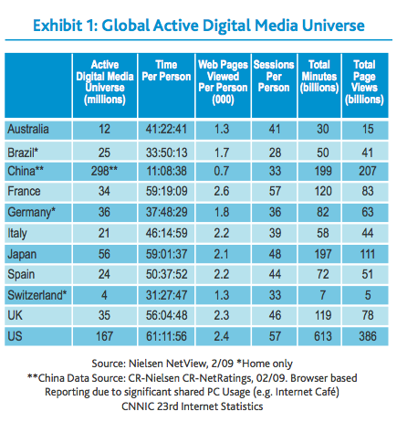
Brazil: Search and Social Media
67.5 million
internet users
40% increase
time spent online (2005 – 2008)
3.7 billion
searches in 2009
53% increase
in searches
5.8%
broadband penetration
http://www.internetworldstats.com/sa/br.htm
http://blog.nielsen.com/nielsenwire/wp-content/uploads/2009/04/nielsen-online-global-lanscapefinal1.pdf
http://techcrunchies.com/category/internet/
http://newsroom.cisco.com/dlls/2009/prod_100209b.html
Notes:
75% US internet access
35% brazil internet access

Slide 9
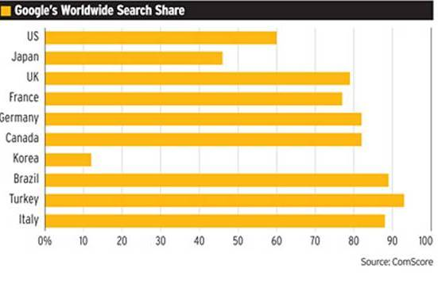
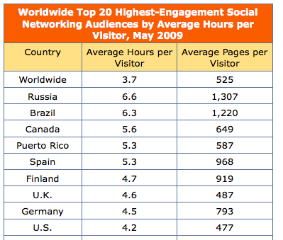
Search and Social Media Market Share
http://www.multilingual-search.com/comscore-reveals-google-share-by-market/30/07/2009
http://searchenginewatch.com/3634929

Slide 10
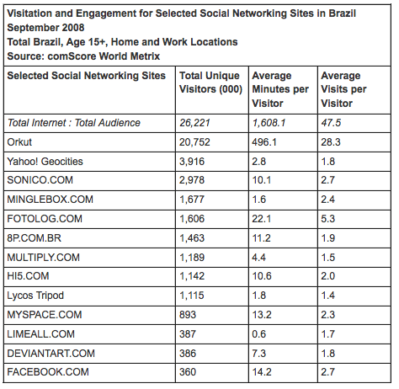


Facebook in Brazil?
http://www.comscore.com/Press_Events/Press_Releases/2008/11/Social_Networking_in_Brazil
Notes:
Orkut – 20 million monthlyvisitors in brazil

Slide 11
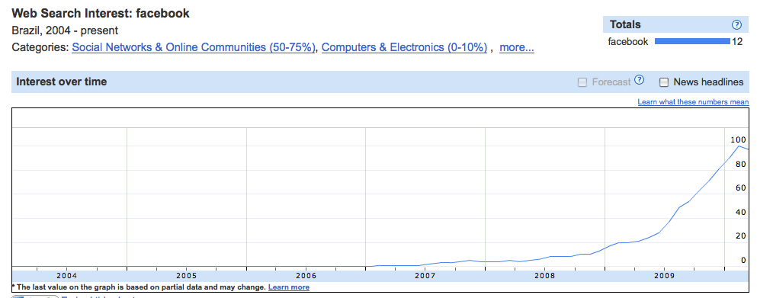
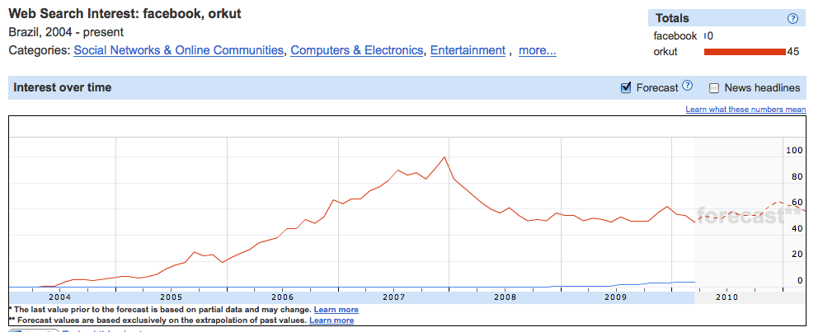
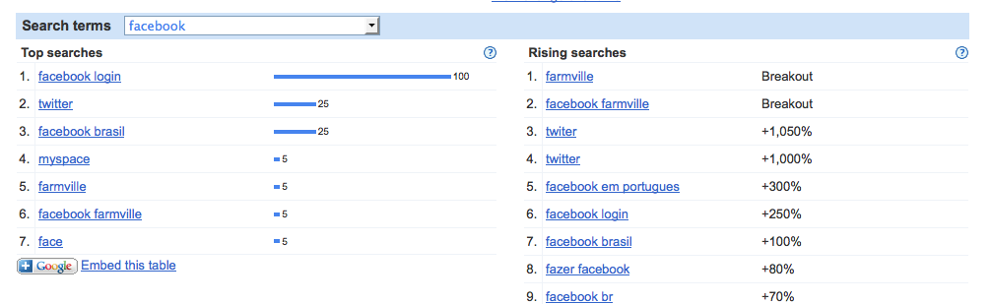
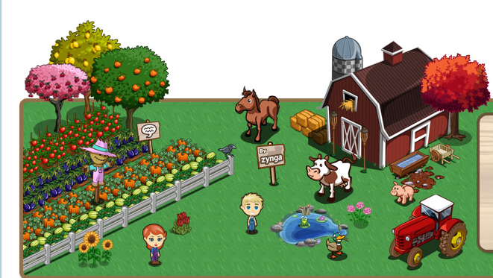

Slide 12
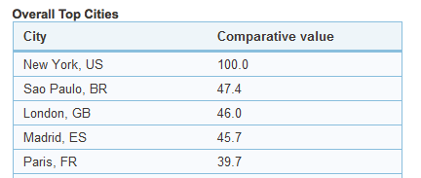
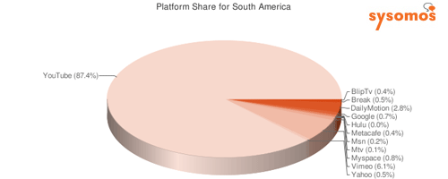
Online Video
Bloggers Who Embed Video
YouTube: 87% Share
http://www.sysomos.com/reports/video/

Slide 13
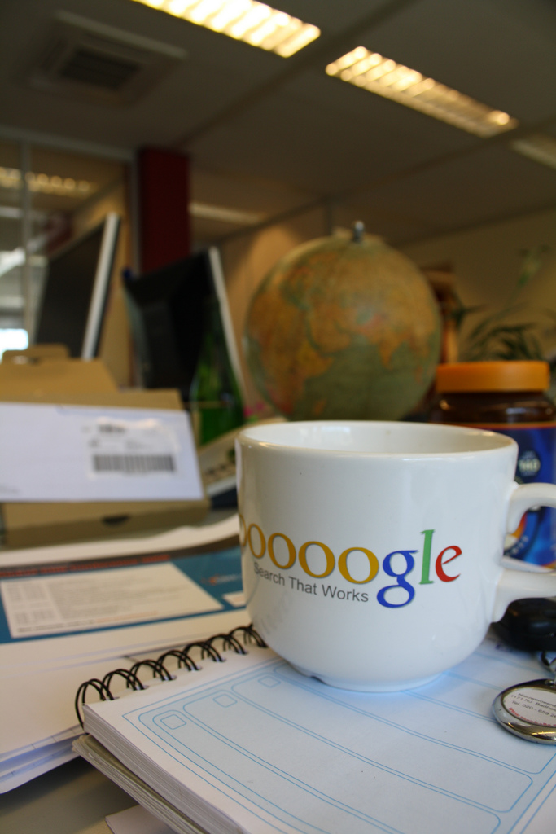
Searcher Personalization
Searcher location (IP-based)
Searcher’s default map location
Search engine TLD accessed
(such as google.ie)
Query language
Regional intent (implicit or explicit)
Country or language restrict settings
Search history
Web history
Social circle
http://www.ninebyblue.com/blog/making-geotargeted-content-findable-for-the-right-searchers/
http://www.flickr.com/photos/wouterkiel/
3532274028/

Slide 14
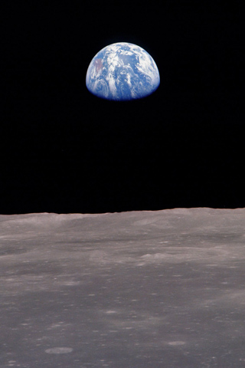
Content Relevance
Site’s physical location
Location of incoming links
Language of pages
Associated address
http://www.flickr.com/photos/fleur-design/698695850/

Slide 15
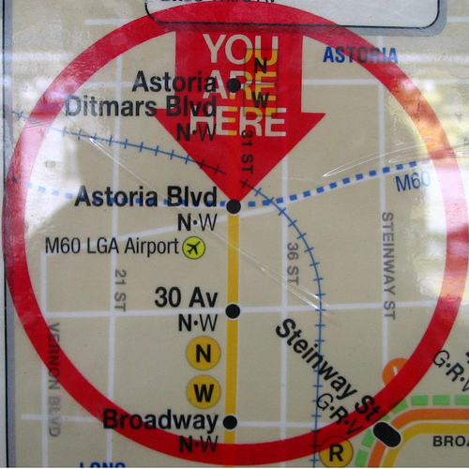
Signaling Location
Country-specific TLD trumps all
IP location used if non-specific TLD
Can set in Google Webmaster Tools
Use separate TLDs if possible
http://www.flickr.com/photos/fleur-design/698695850/
http://www.flickr.com/photos/vidiot/69073063/

Slide 16
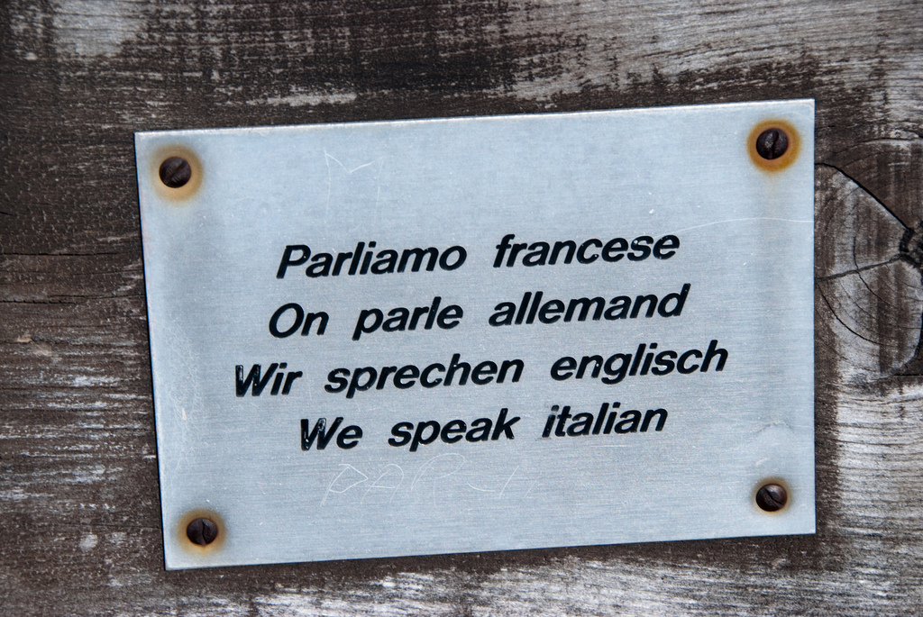
Signaling Language
One language per page
(preferably per folder/subdomain)
All elements (including meta
description, title etc.) in same
language
Google ignores lang DTD attributes
Meta language tag likely ignored
Use escaped, UTF-8 encoded URLs
Link to other language versions
http://www.flickr.com/photos/fleur-design/698695850/
http://www.flickr.com/photos/magdalar/2950663799/

Slide 17
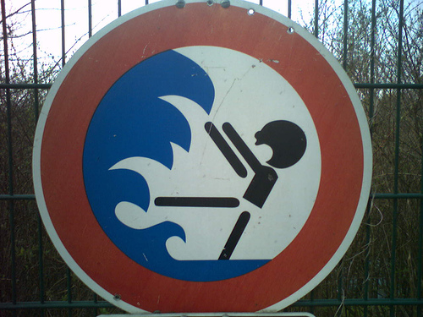
Things to Avoid
Don’t mix languages on one URL
Don’t let automated translations
be crawled (or use canonicalization)
Don’t autodirect (especially
without linking to other versions)
Don’t load different content on
one URL
Don’t use parameters to specify country or language
http://www.flickr.com/photos/fleur-design/698695850/
http://www.flickr.com/photos/e-rol/443821479/

Slide 18
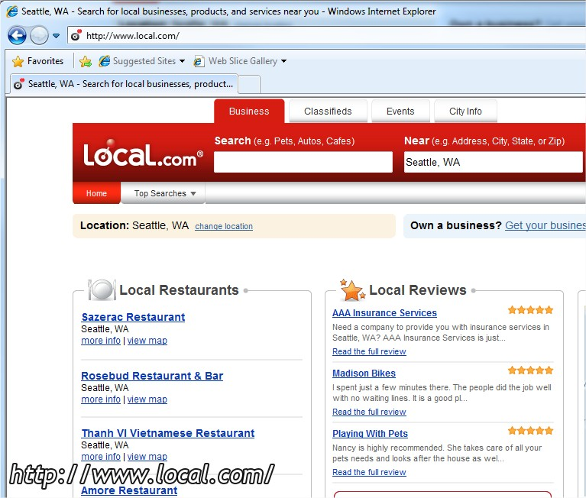
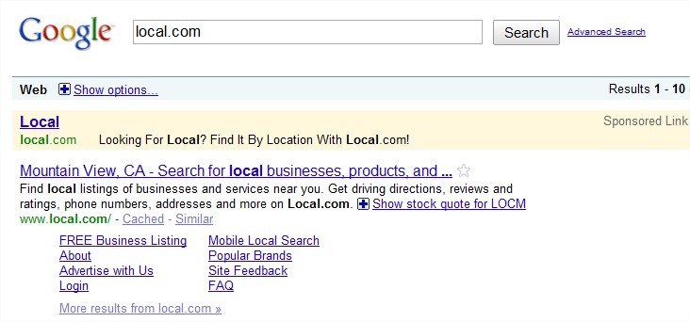
Issues With Geotargeting Content

Slide 19
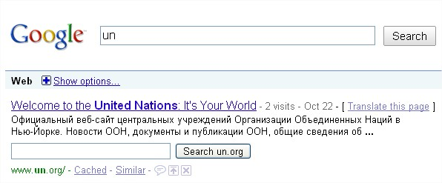
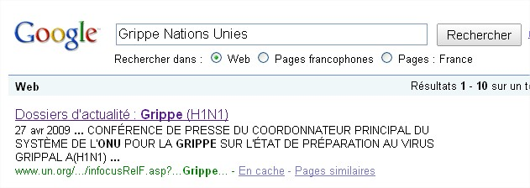

Issues With Search Results Display
http://www.flickr.com/photos/fleur-design/698695850/

Slide 20

Duplicate Content
Generally, don’t worry about
penalties
Remember relevance: search
engines will show what’s most
relevant and filter the rest
Localize for your audience
http://www.flickr.com/photos/fleur-design/698695850/
http://www.flickr.com/photos/popilop/331357312/

Slide 21
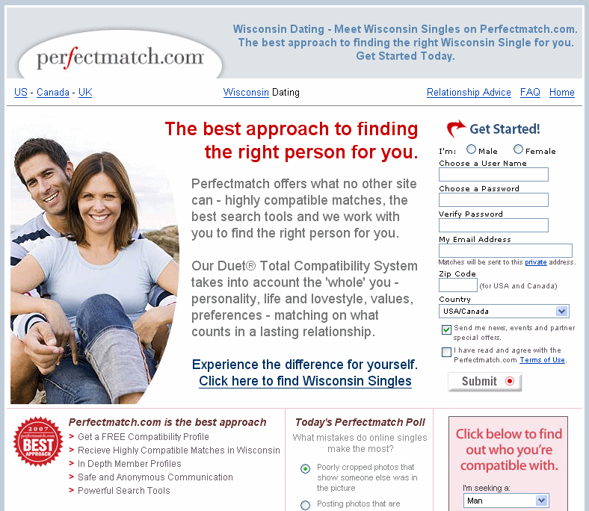
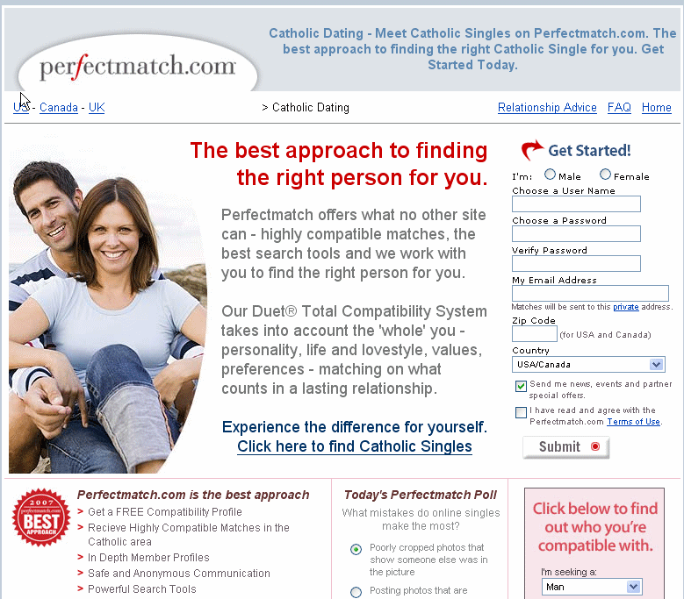
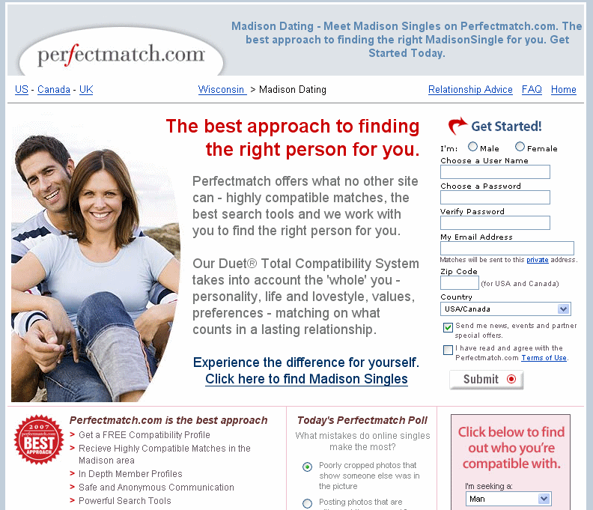
When to Worry About Duplicate Content
http://www.flickr.com/photos/fleur-design/698695850/

Slide 22
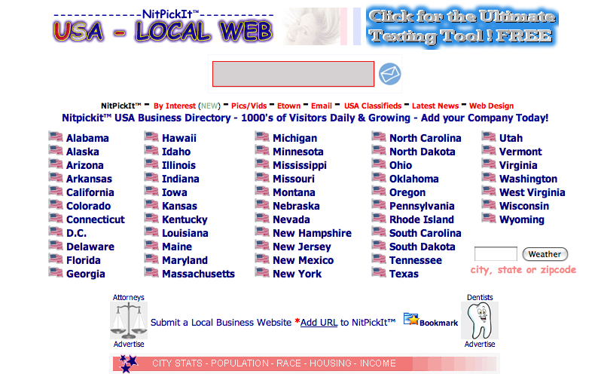
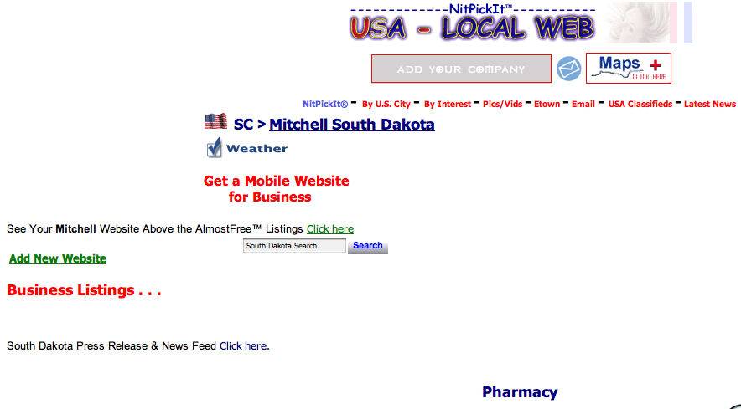
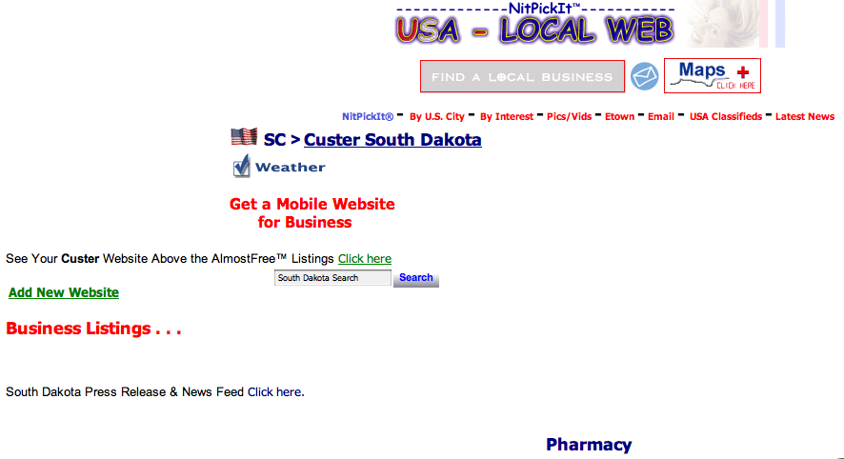
Empty Content
http://www.flickr.com/photos/fleur-design/698695850/

Slide 23
http://www.flickr.com/photos/14646075@N03/3498450536/
Notes:
Normally like to have slide with inspirational pictures rather than words and bullets

Slide 24
Questions?
@vanessafox

